Slide 1
DC Circuits
Equivalent Resistance
By Dr. Ahmed S. Abdullah
د. احمد سليمان عبدالله

Slide 2
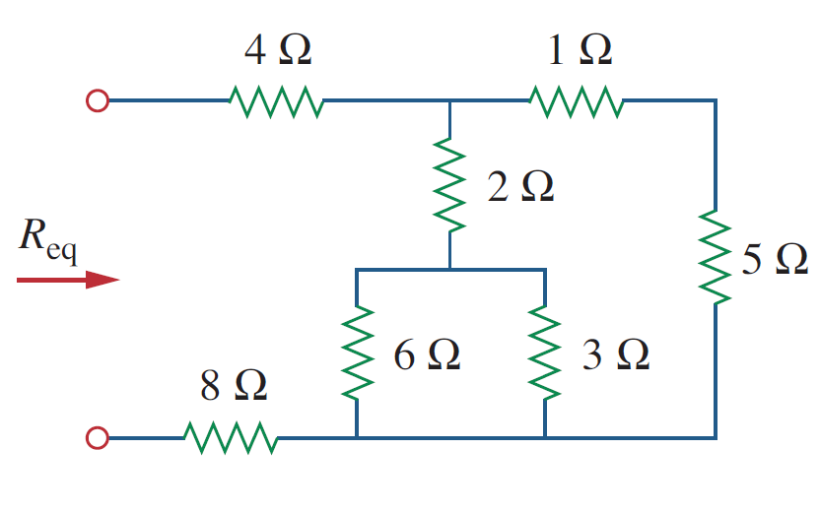
Equivalent Resistance
Example 1:

Slide 3
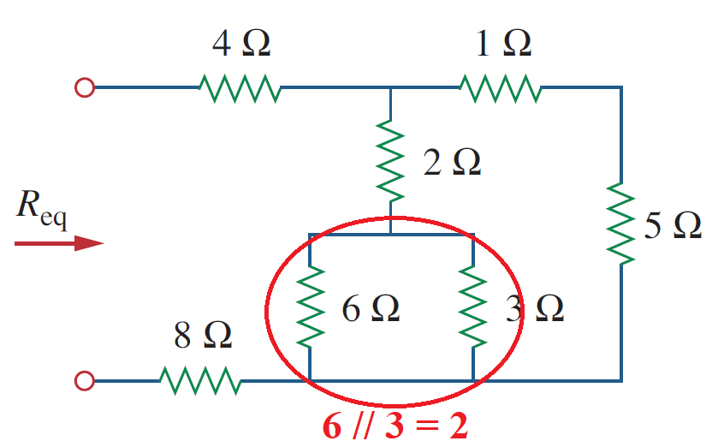
Equivalent Resistance
Example 1:
$$\frac{6×3}{6+3}= \frac{18}{9}=2 Ω$$

Slide 4
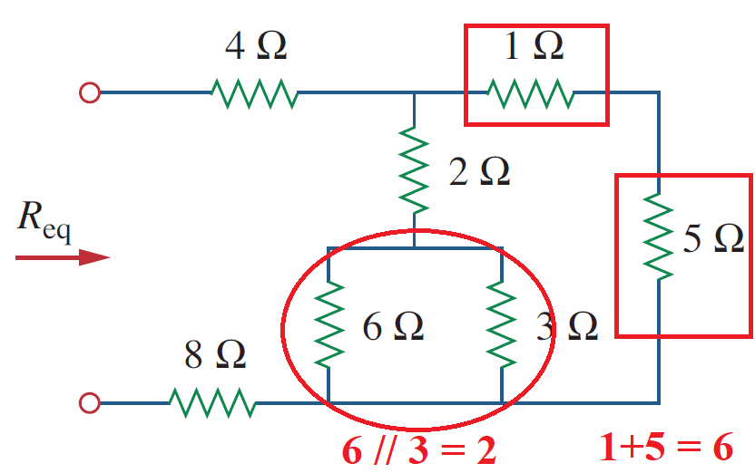
Equivalent Resistance
Example 1:

Slide 5
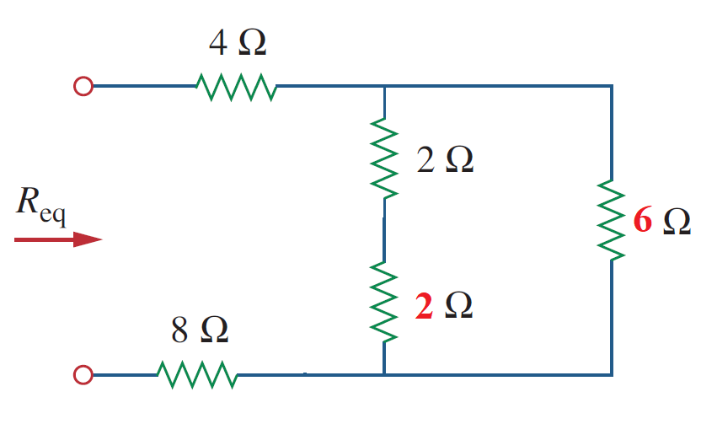
Equivalent Resistance
Example 1:

Slide 6
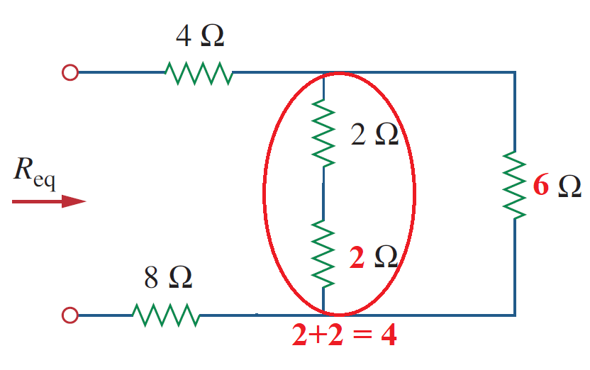
Equivalent Resistance
Example 1:

Slide 7
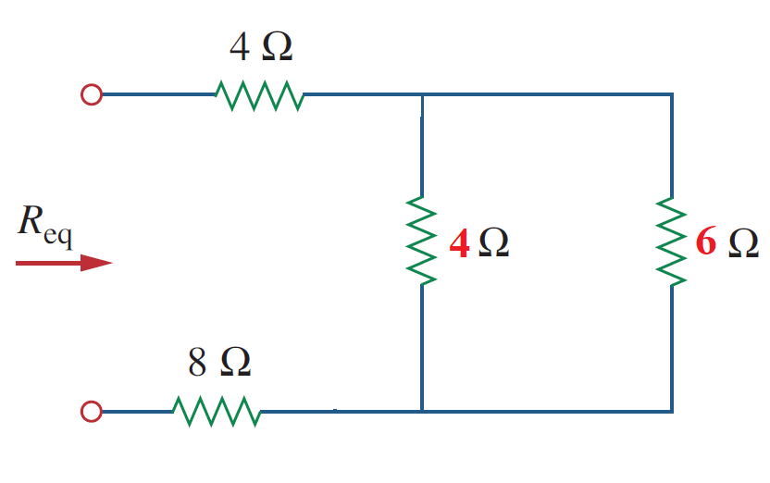
Equivalent Resistance
Example 1:

Slide 8
Equivalent Resistance
Example 1:
$$\frac{4×6}{4+6}= \frac{24}{10}=2.4 Ω$$
4//6 = 2.4

Slide 9
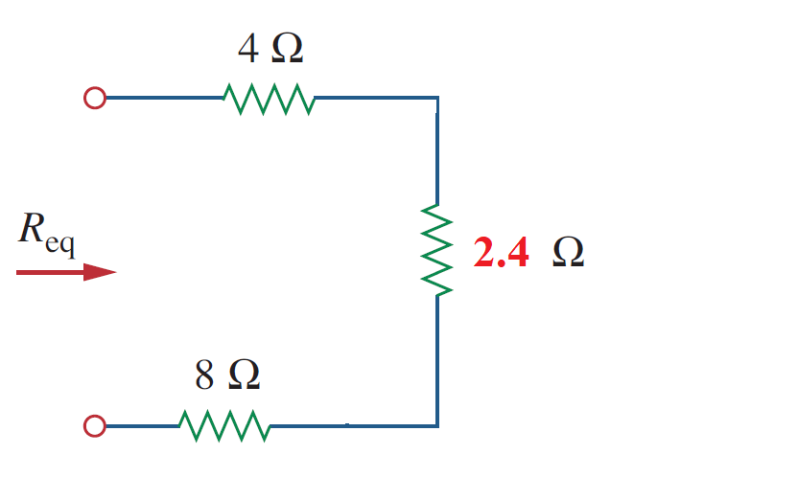
Equivalent Resistance
Example 1:

Slide 10
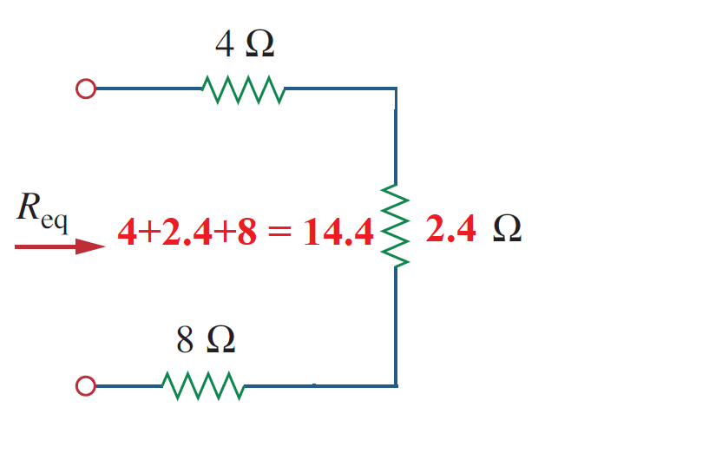
Equivalent Resistance
Example 1:

Slide 11
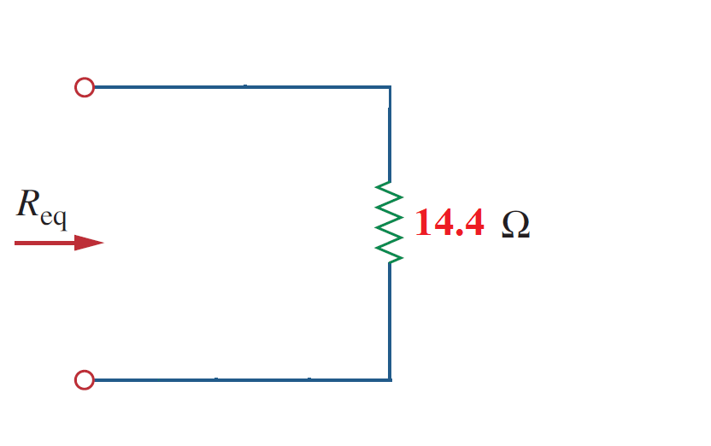
Equivalent Resistance
Example 1:

Slide 12
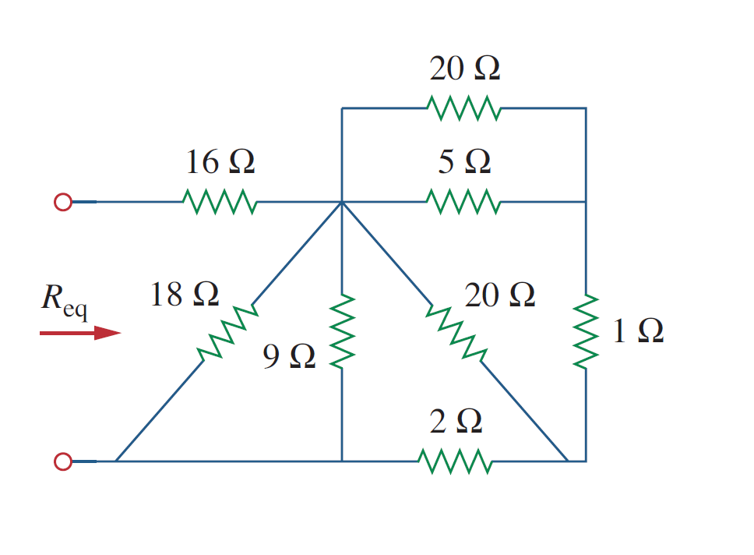
Equivalent Resistance
Example 2:

Slide 13
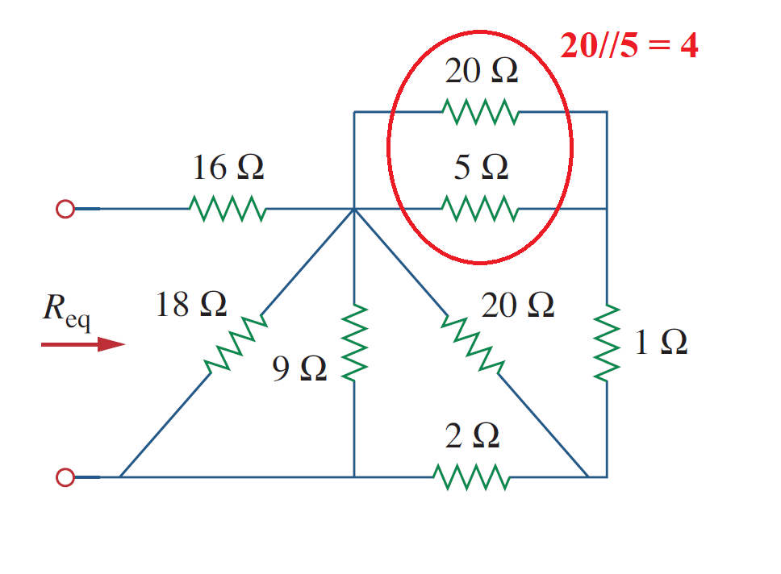
Equivalent Resistance
Example 2:
$$\frac{20×5}{20+5}= \frac{100}{25}=4 Ω$$

Slide 14
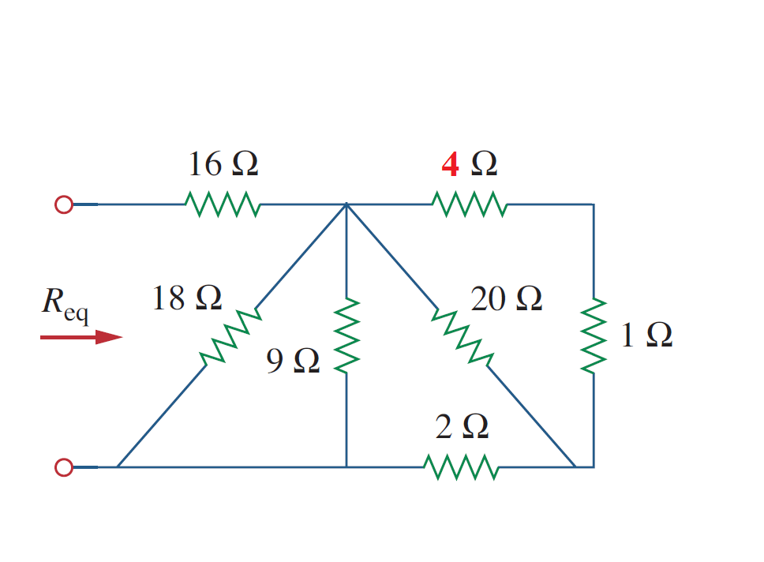
Equivalent Resistance
Example 2:

Slide 15
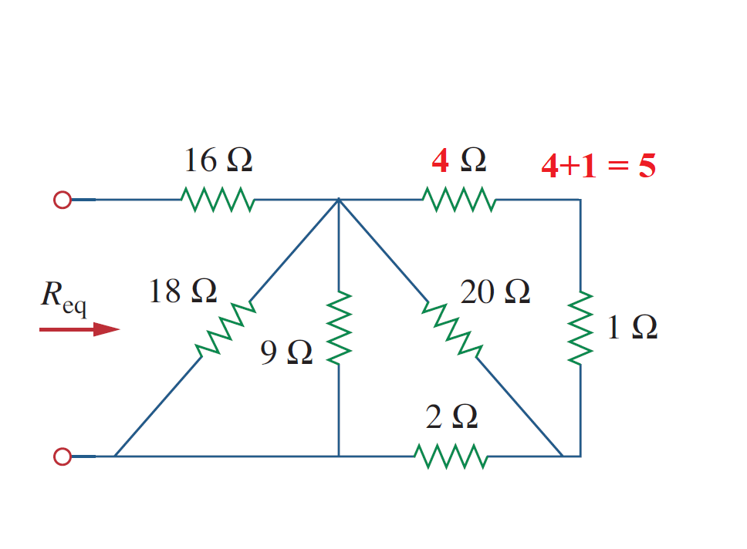
Equivalent Resistance
Example 2:

Slide 16
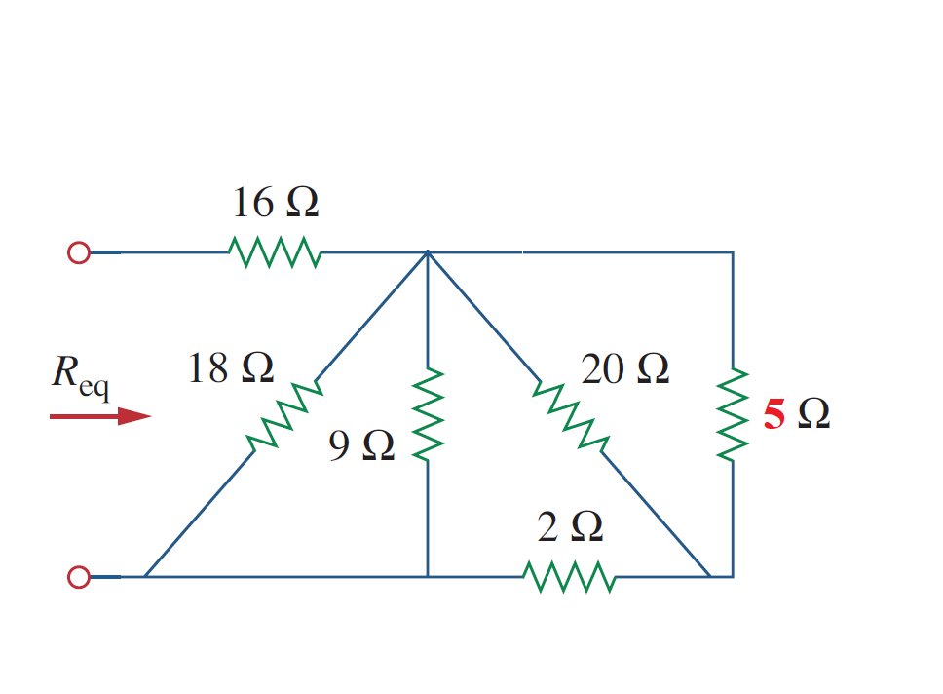
Equivalent Resistance
Example 2:

Slide 17
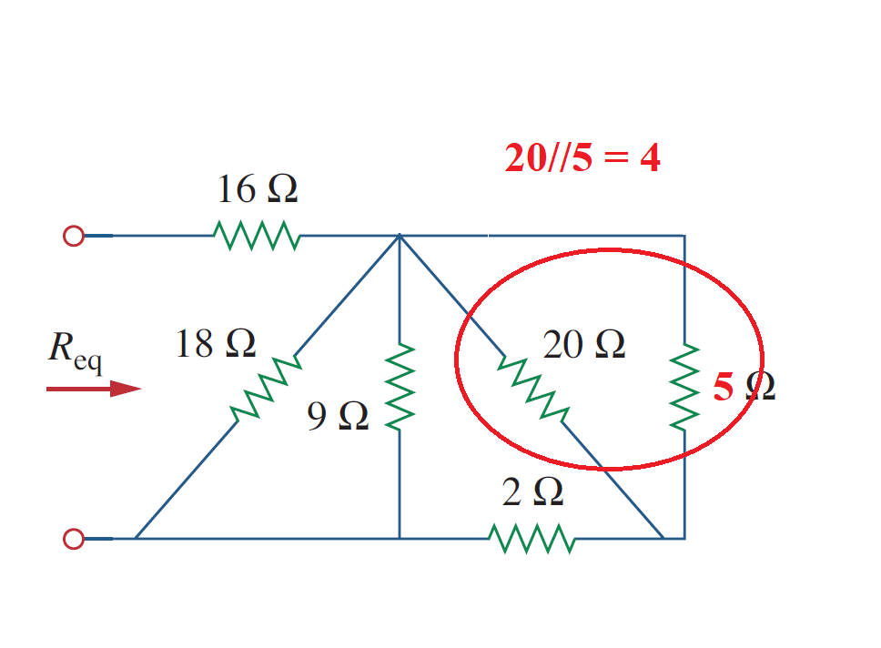
Equivalent Resistance
Example 2:
$$\frac{20×5}{20+5}= \frac{100}{25}=4 Ω$$

Slide 18
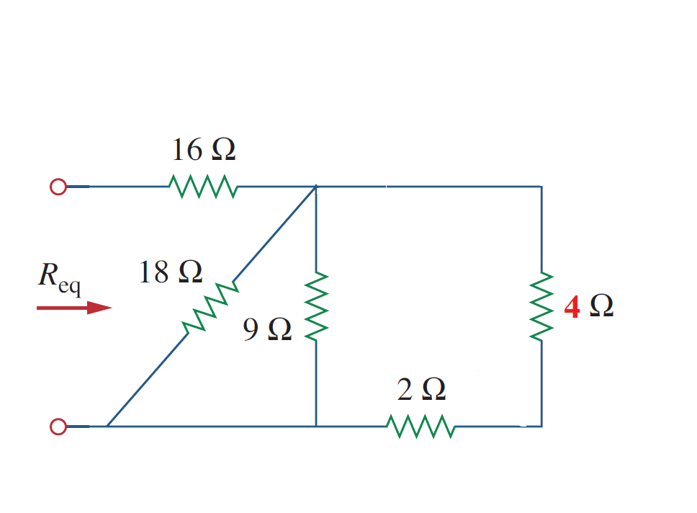
Equivalent Resistance
Example 2:

Slide 19
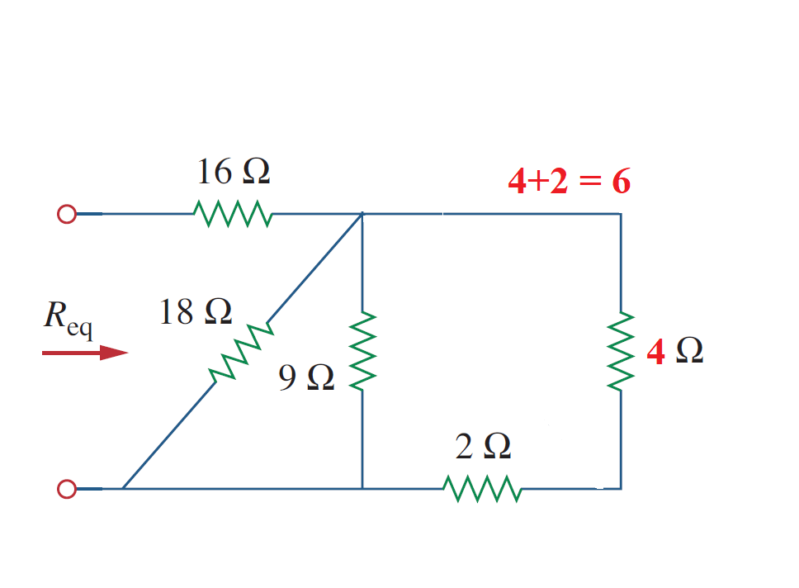
Equivalent Resistance
Example 2:

Slide 20
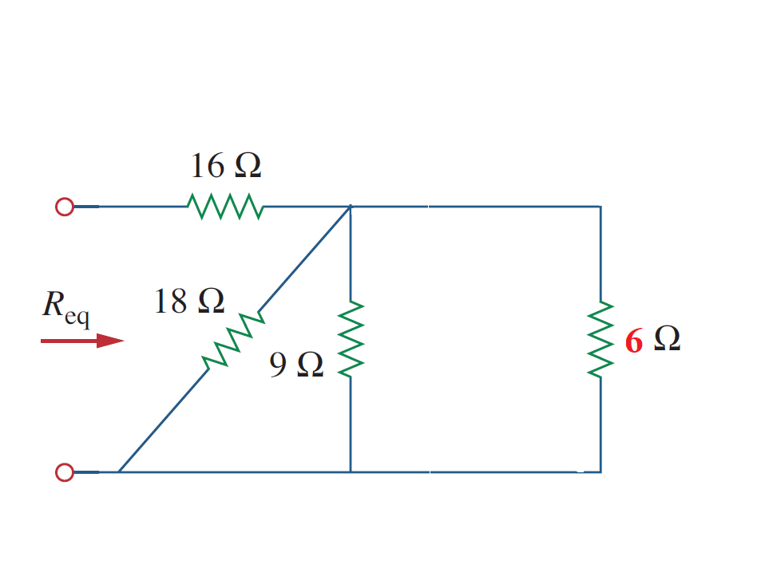
Equivalent Resistance
Example 2:

Slide 21
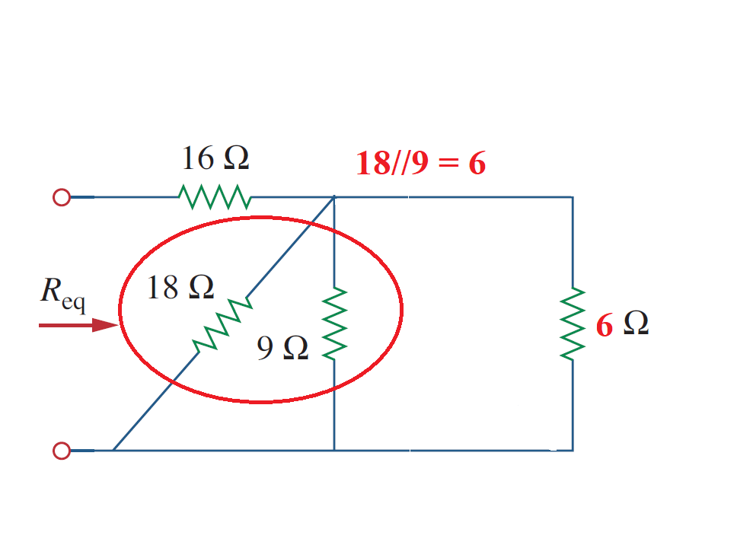
Equivalent Resistance
Example 2:
$$\frac{18×9}{18+9}= \frac{162}{27}=6 Ω$$

Slide 22
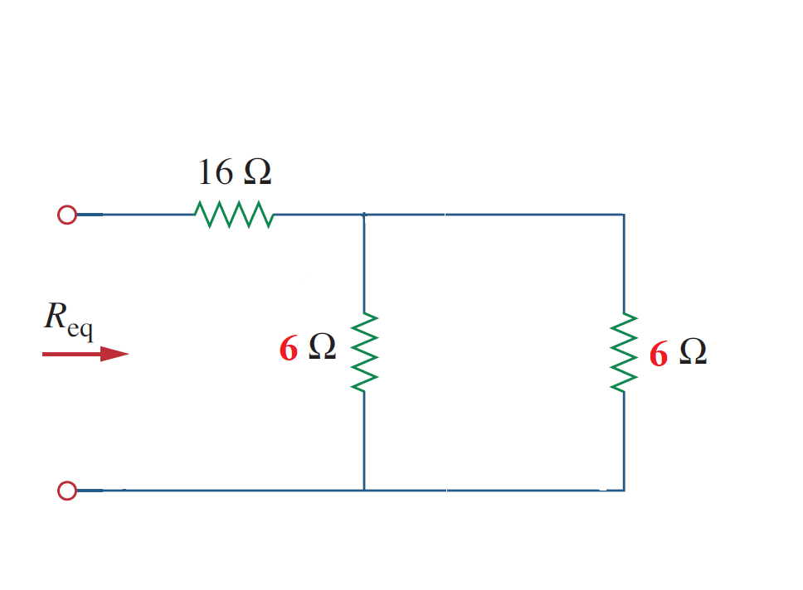
Equivalent Resistance
Example 2:

Slide 23
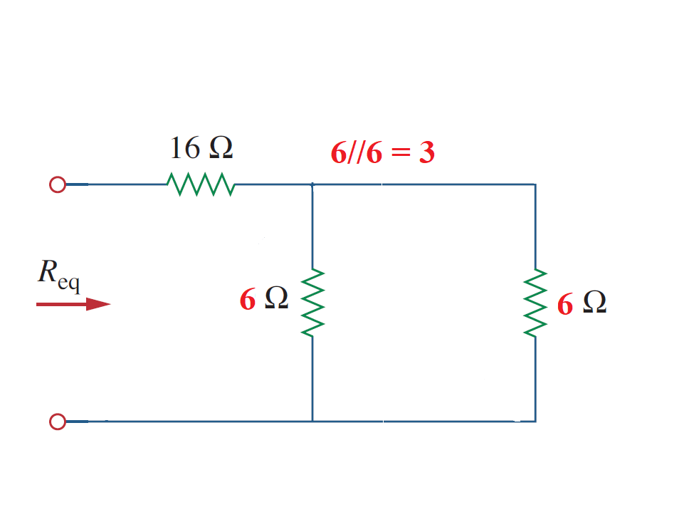
Equivalent Resistance
Example 2:
$$\frac{6×6}{6+6}= \frac{36}{12}=3 Ω$$

Slide 24
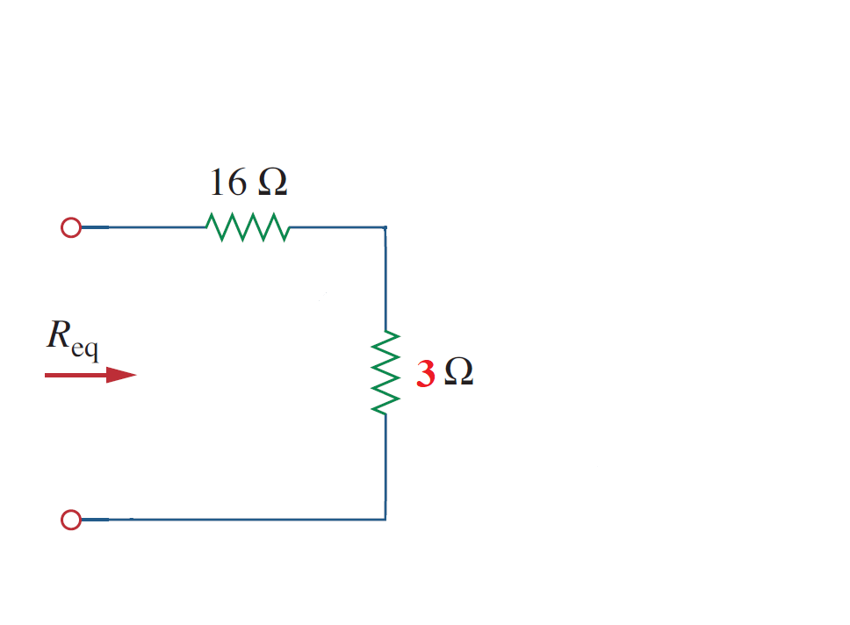
Equivalent Resistance
Example 2:

Slide 25
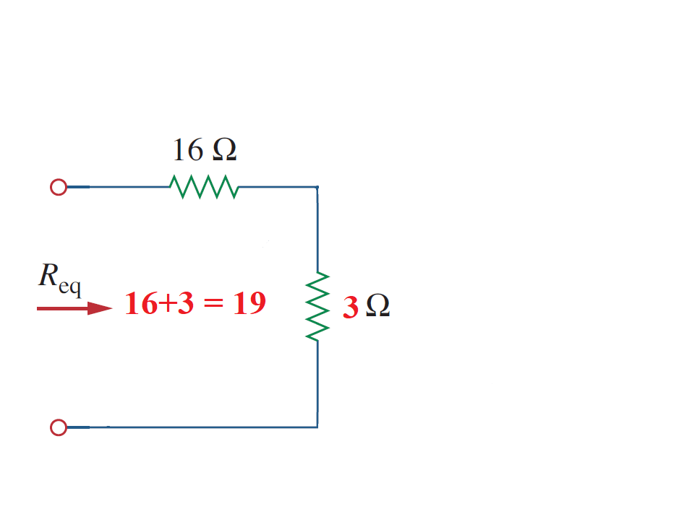
Equivalent Resistance
Example 2:

Slide 26
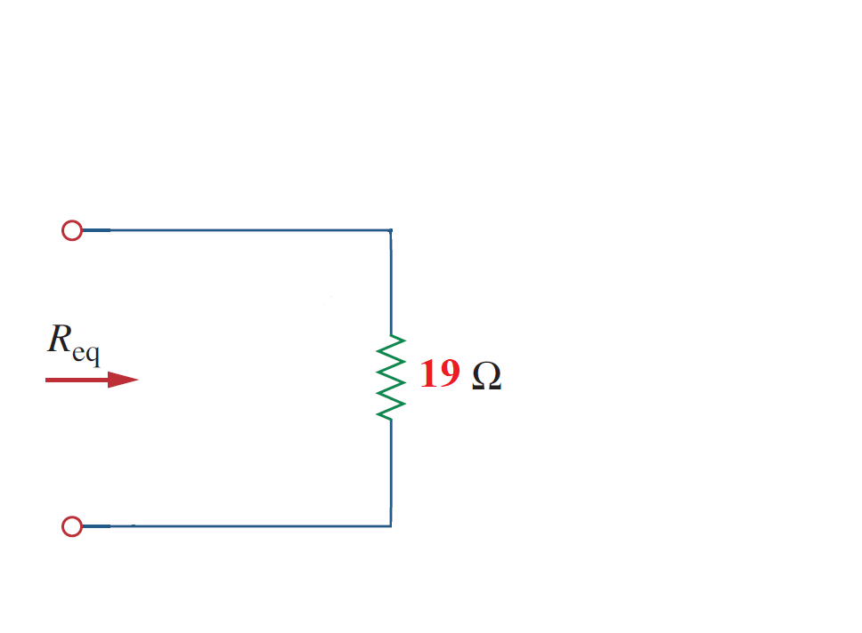
Equivalent Resistance
Example 2:

Slide 27
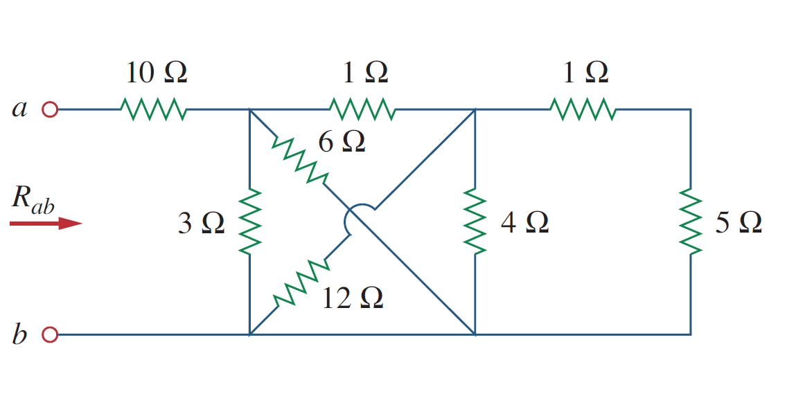
Equivalent Resistance
Example 3:

Slide 28
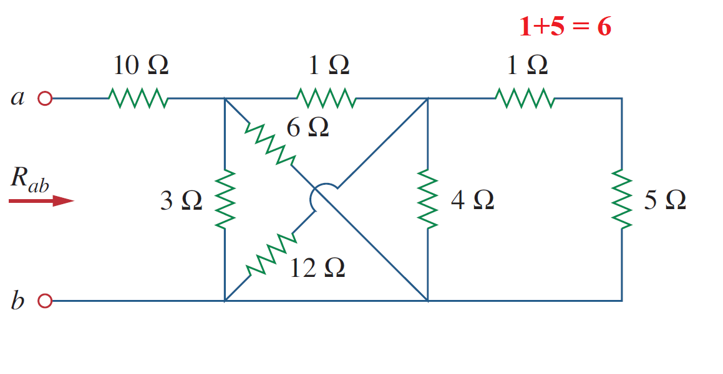
Equivalent Resistance
Example 3:

Slide 29
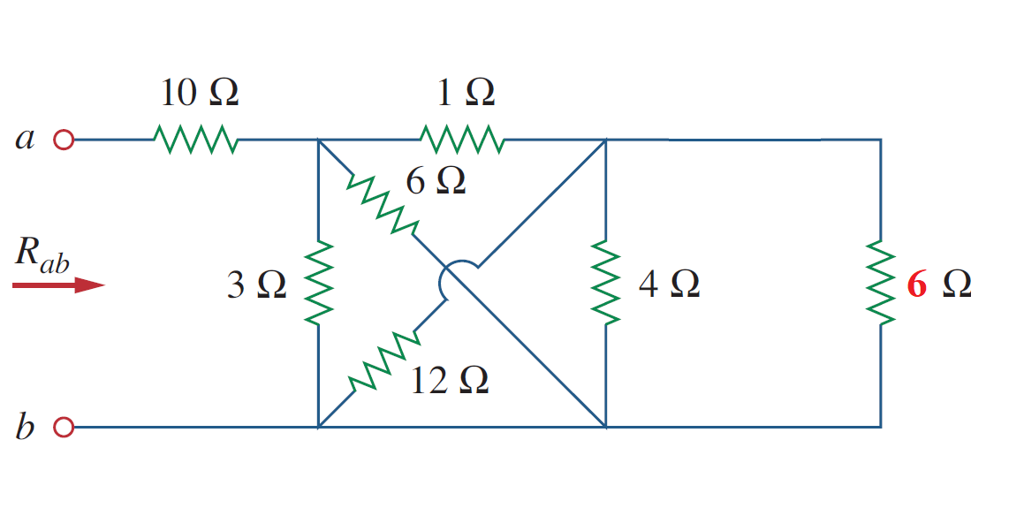
Equivalent Resistance
Example 3:

Slide 30
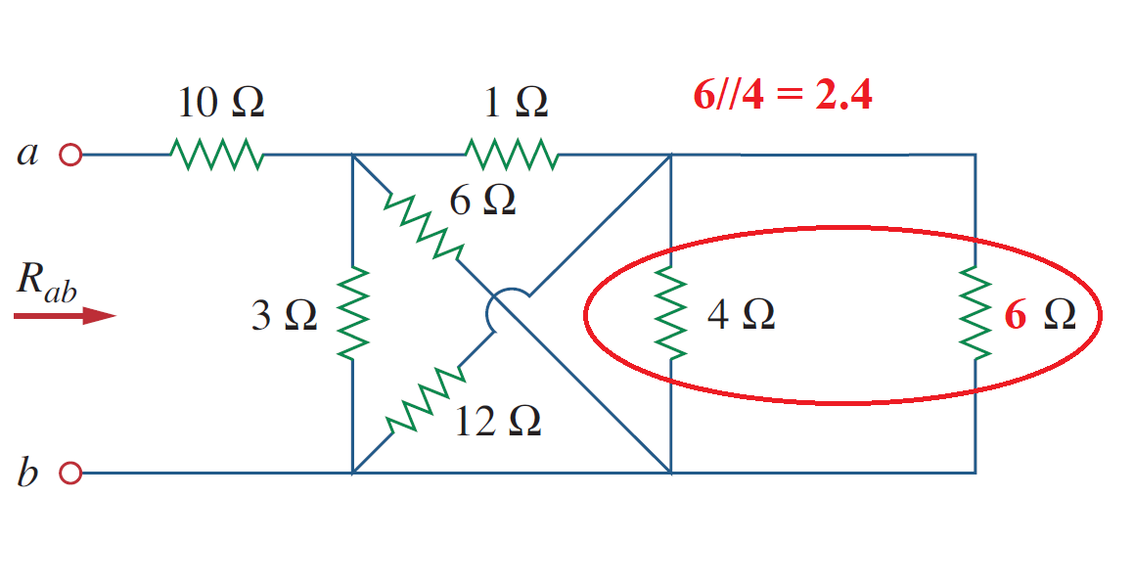
Equivalent Resistance
Example 3:
$$\frac{6×4}{6+4}= \frac{24}{10}=2.4 Ω$$

Slide 31
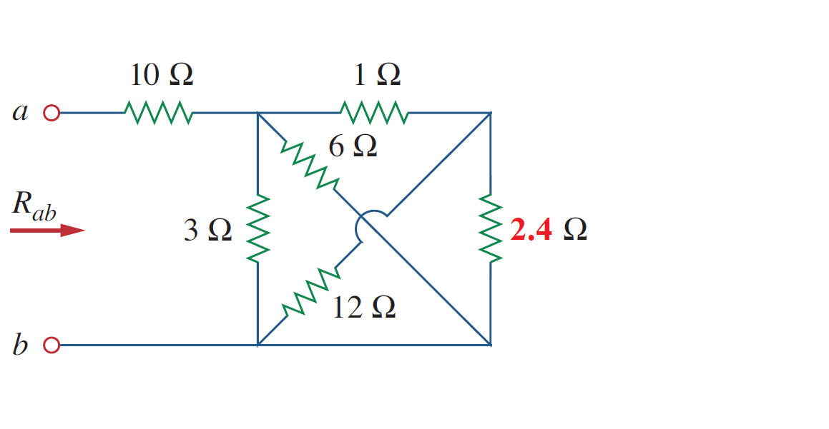
Equivalent Resistance
Example 3:

Slide 32
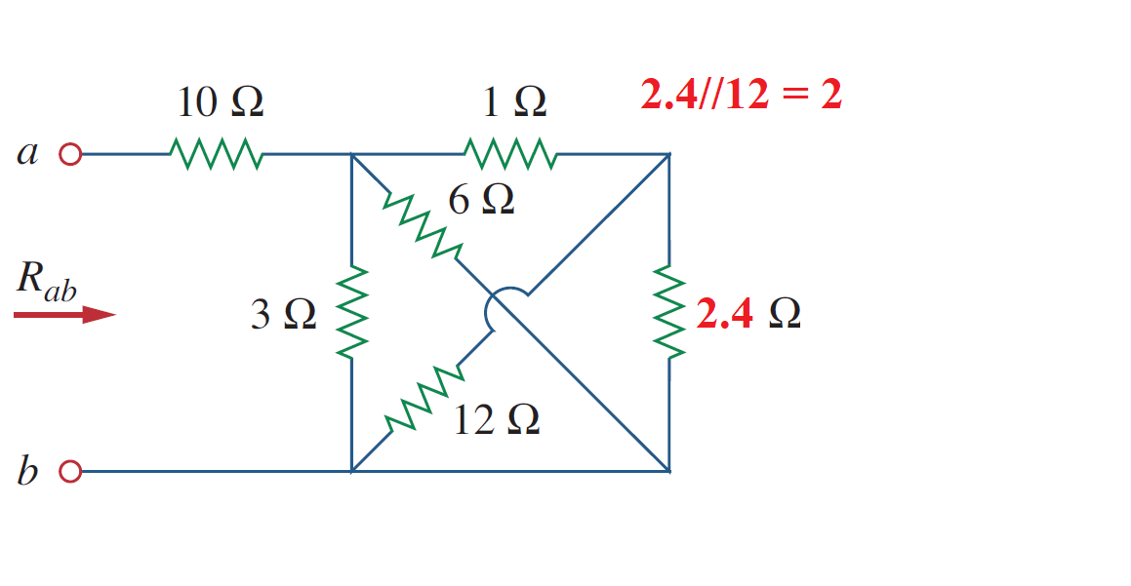
Equivalent Resistance
Example 3:
$$\frac{2.4×12}{2.4+12}= \frac{28.8}{14.4}=2 Ω$$

Slide 33
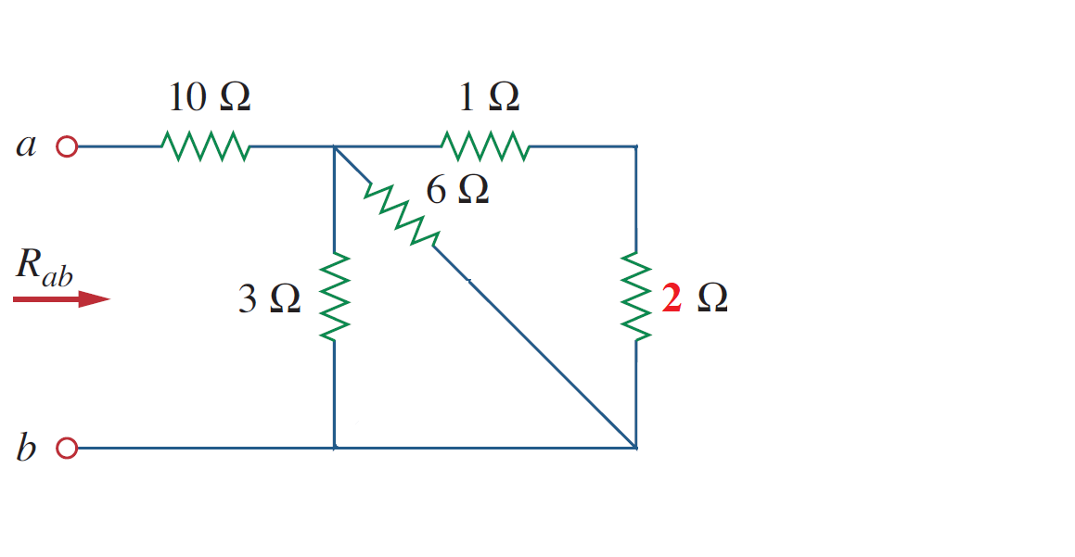
Equivalent Resistance
Example 3:

Slide 34
Equivalent Resistance
Example 3:
1+2 = 3

Slide 35
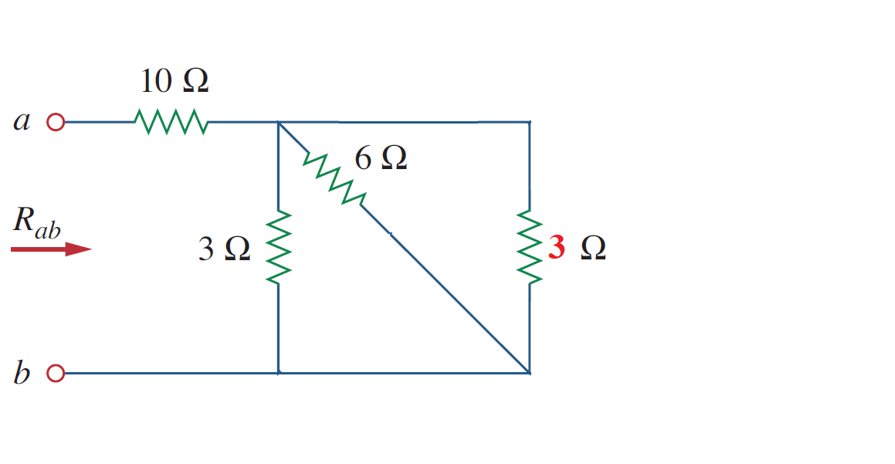
Equivalent Resistance
Example 3:

Slide 36
Equivalent Resistance
Example 3:
$$\frac{6×3}{6+3}= \frac{18}{9}=2 Ω$$
6//3 = 2

Slide 37
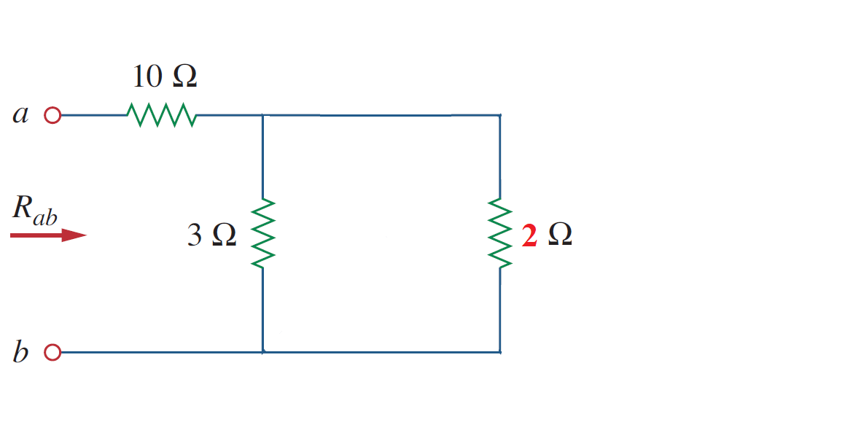
Equivalent Resistance
Example 3:

Slide 38
Equivalent Resistance
Example 3:
$$\frac{3×2}{3+2}= \frac{6}{5}=1.2 Ω$$
3//2 = 1.2

Slide 39
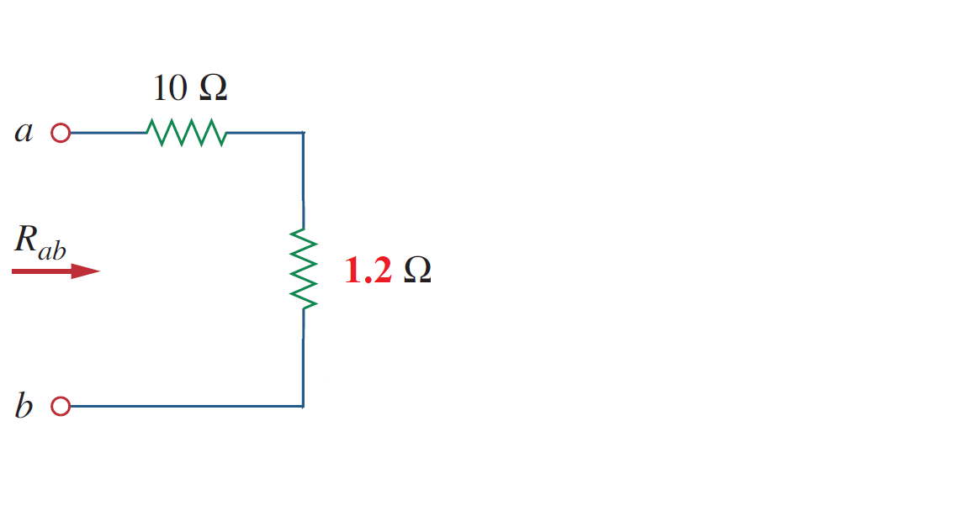
Equivalent Resistance
Example 3:

Slide 40
Equivalent Resistance
Example 3:
10+1.2 = 11.2

Slide 41
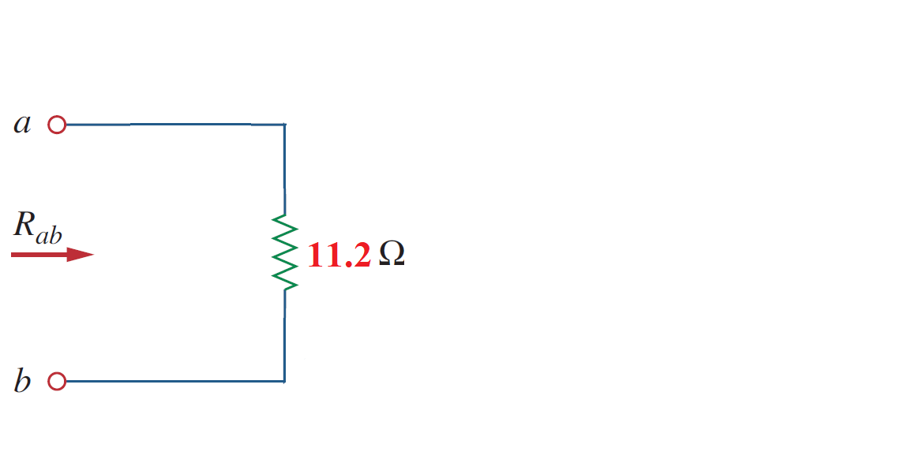
Equivalent Resistance
Example 3:

Slide 42
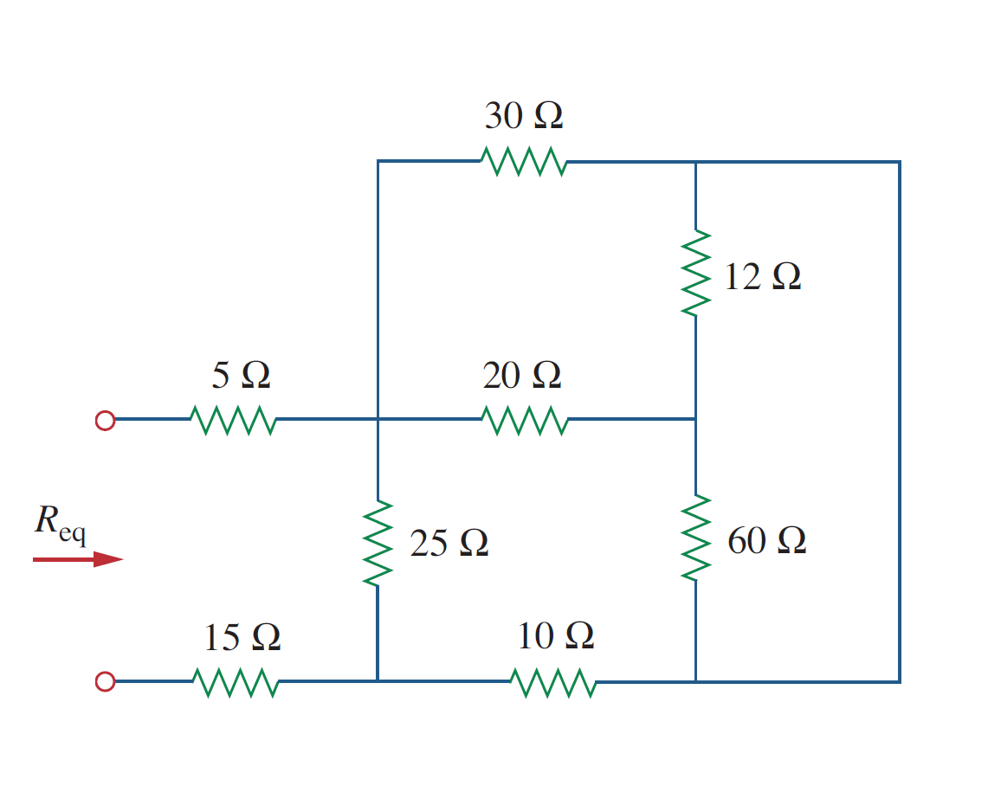
Equivalent Resistance
Example 4:

Slide 43
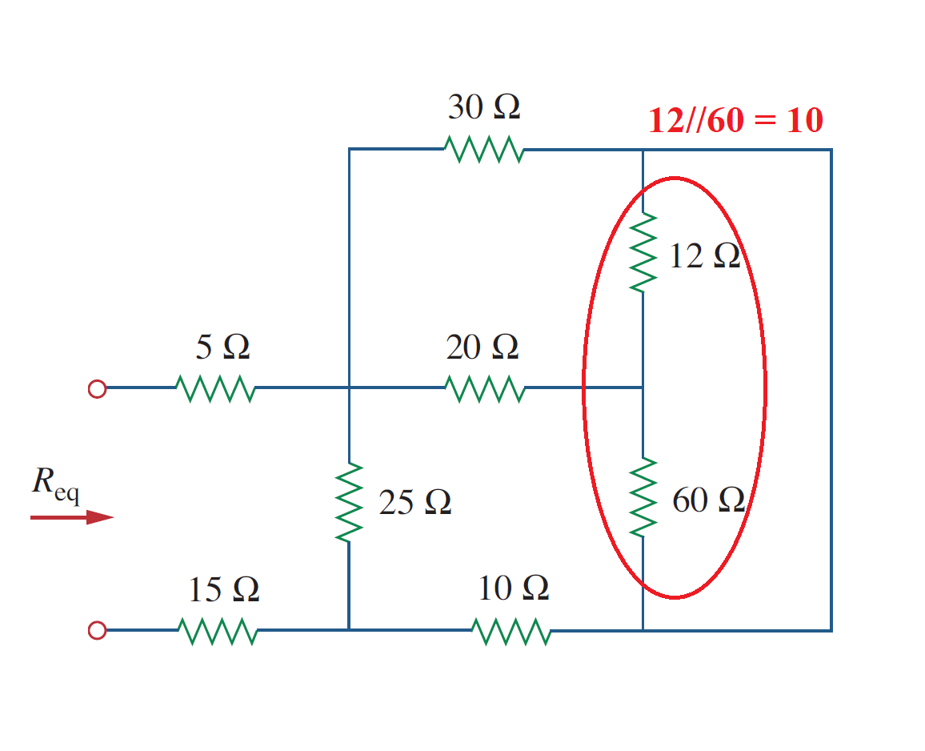
Equivalent Resistance
Example 4:
$$\frac{12×60}{12+60}= \frac{720}{72}=10 Ω$$

Slide 44
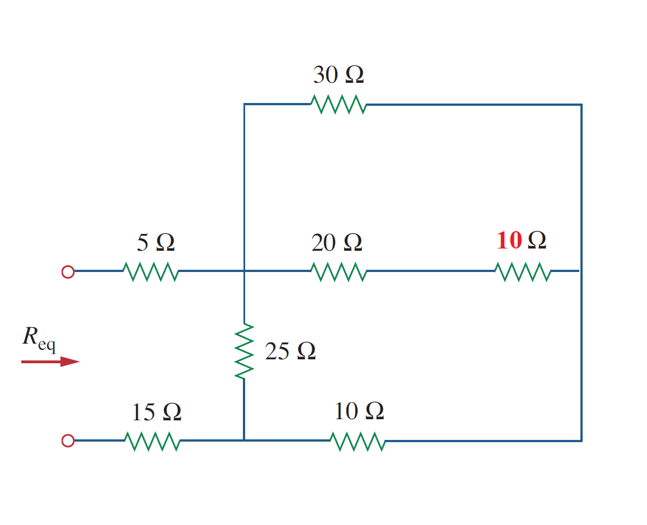
Equivalent Resistance
Example 4:

Slide 45
Equivalent Resistance
Example 4:
20+10 = 30

Slide 46
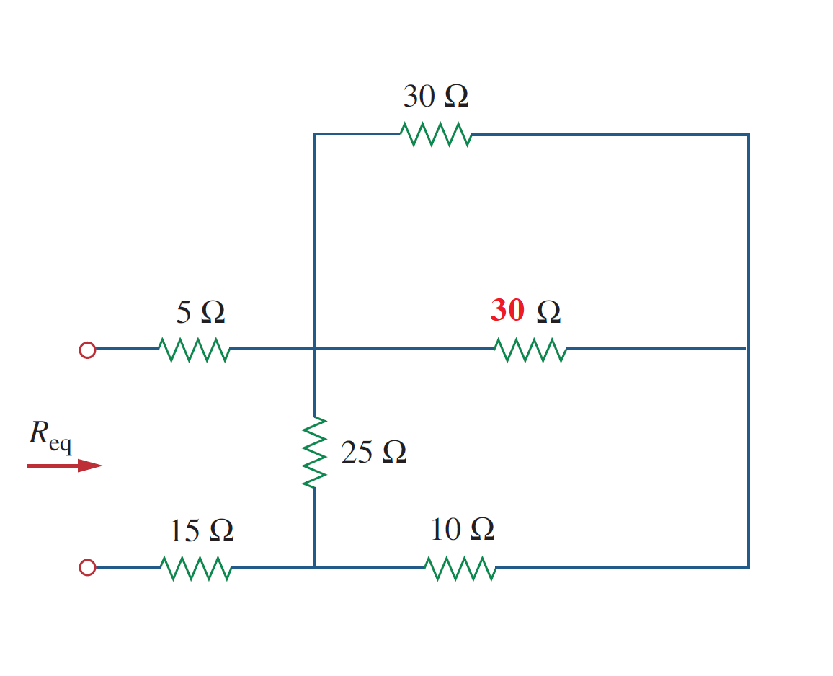
Equivalent Resistance
Example 4:

Slide 47
Equivalent Resistance
Example 4:
$$\frac{30×30}{30+30}= \frac{900}{60}=15 Ω$$
30//30 = 15

Slide 48
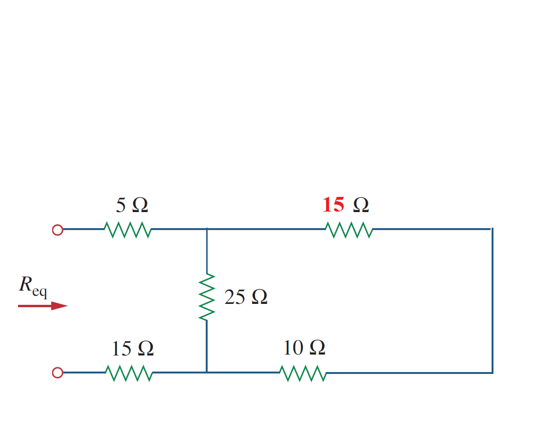
Equivalent Resistance
Example 4:

Slide 49
Equivalent Resistance
Example 4:
15+10 = 25

Slide 50
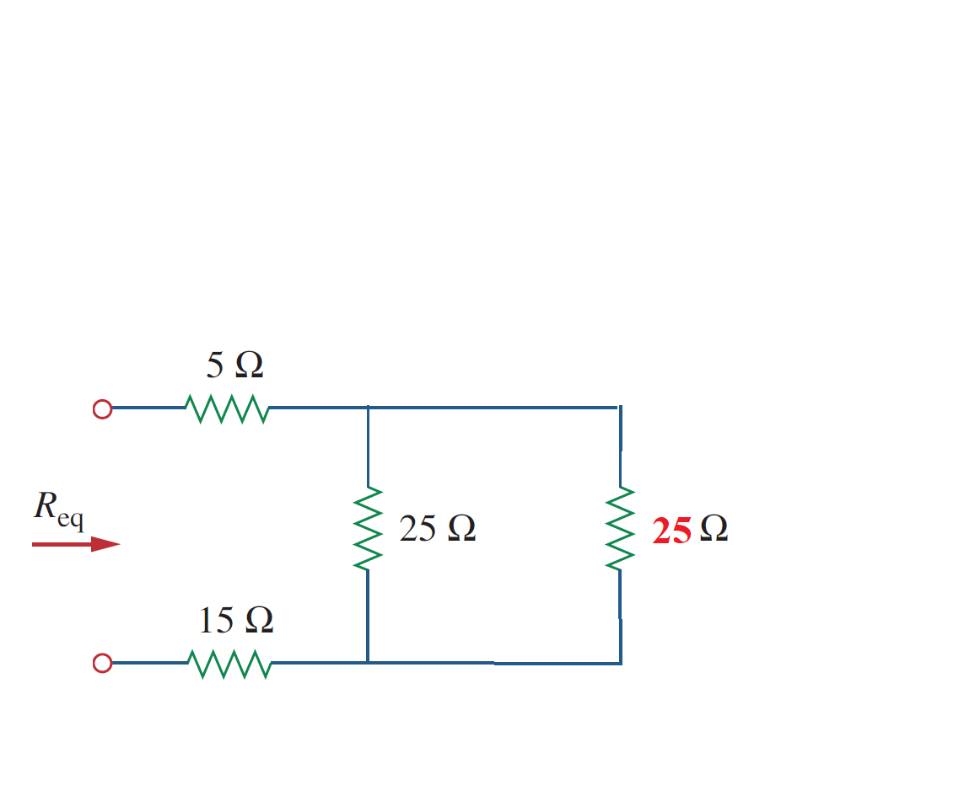
Equivalent Resistance
Example 4:
$$\frac{25×25}{25+25}= \frac{625}{50}=15 Ω$$
25//25 = 12.5

Slide 51
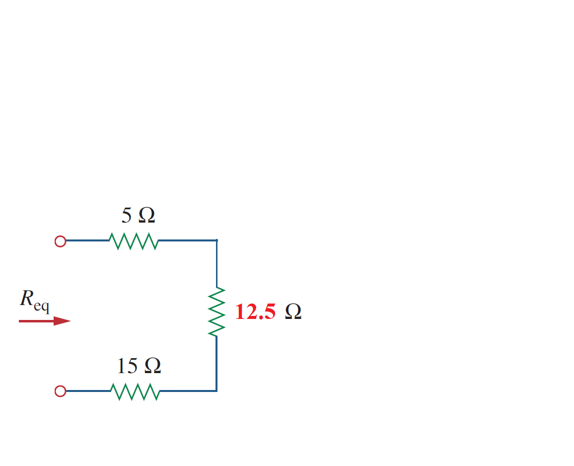
Equivalent Resistance
Example 4:

Slide 52
Equivalent Resistance
Example 4:
5+12.5+15 = 32.5 Ω

Slide 53
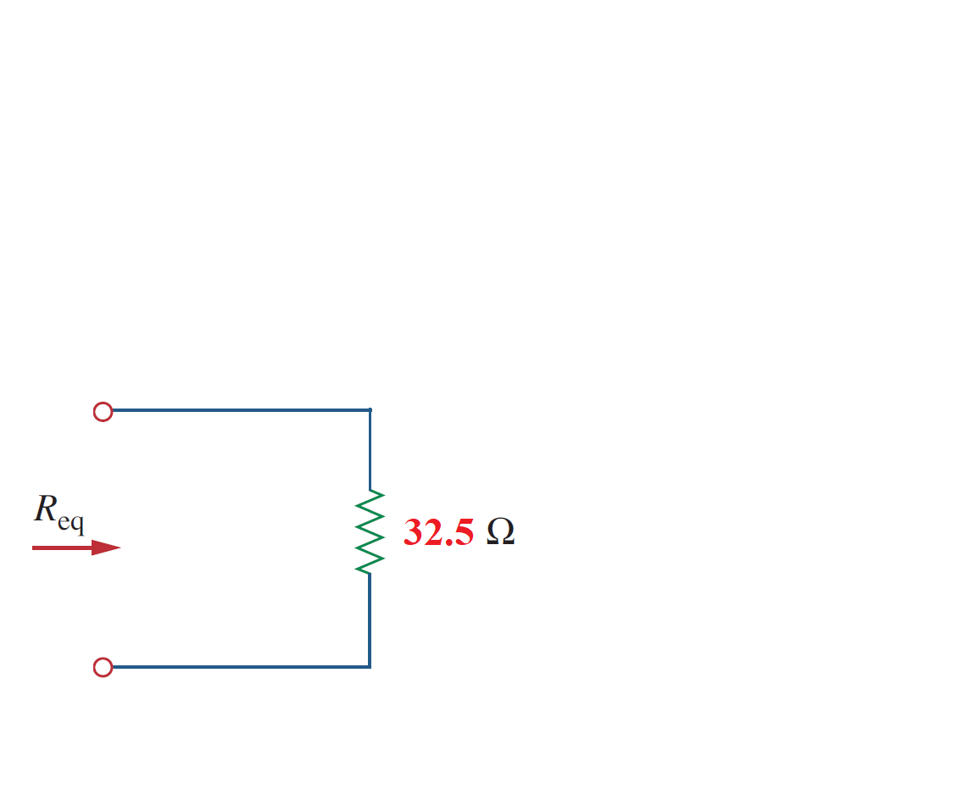
Equivalent Resistance
Example 4:

Slide 54
References
Boylestad, Robert L. Introductory circuit analysis. Pearson Education, 2010.
Robbins, Allan H., and Wilhelm C. Miller. Circuit analysis: Theory and practice. Cengage Learning, 2012.
Sadiku, Matthew NO, and Chales K. Alexander. Fundamentals of electric circuits. McGraw-Hill Higher Education, 2007.

